Slide 1
Artificial Intelligence Boosting w/out Code
Self-Service AI & Deep Learning
William Hill
Lead Data Scientist
william.hill@vion.com
github.com/will-hill

Slide 2
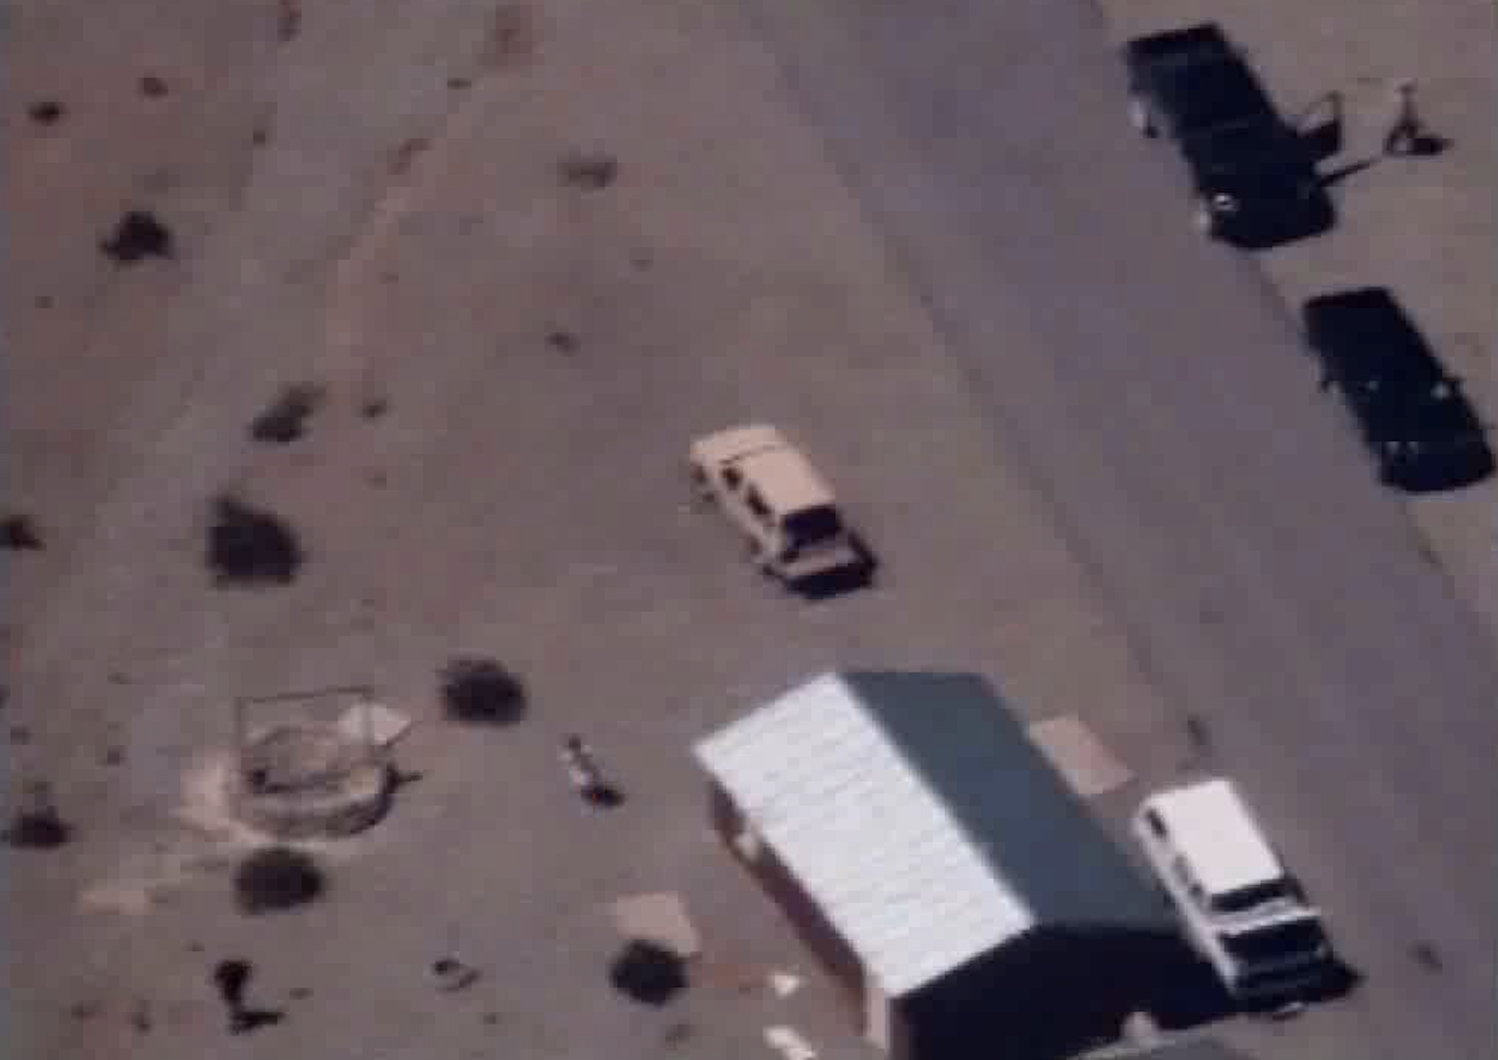
false positive
true negative
How do we fix these?
true positive
false negative

Slide 3
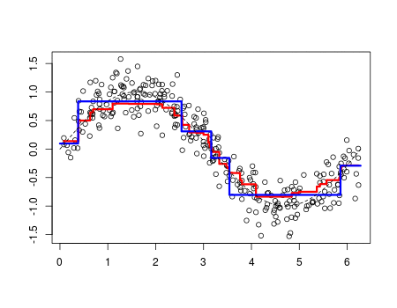
Boosting
“update weights of incorrectly classified images”

Slide 4


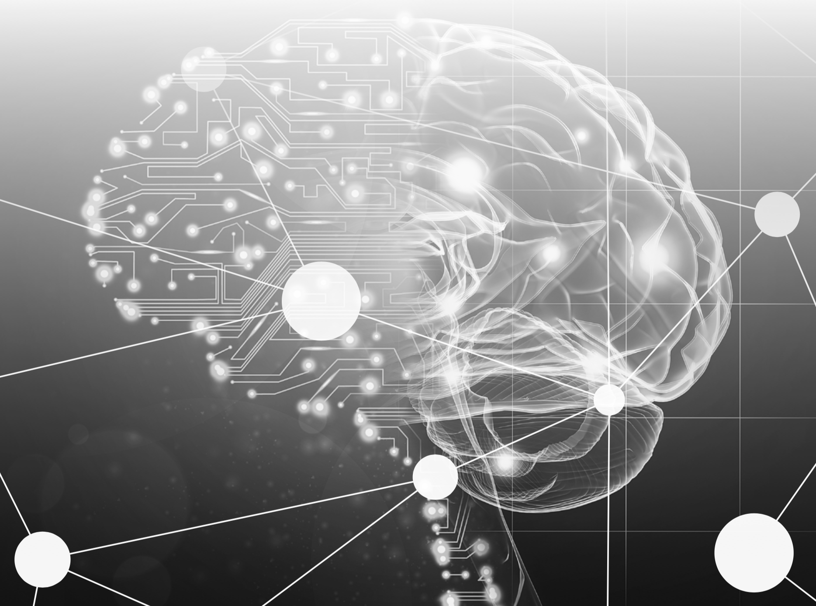





AI Boosting
person
not person

Slide 5
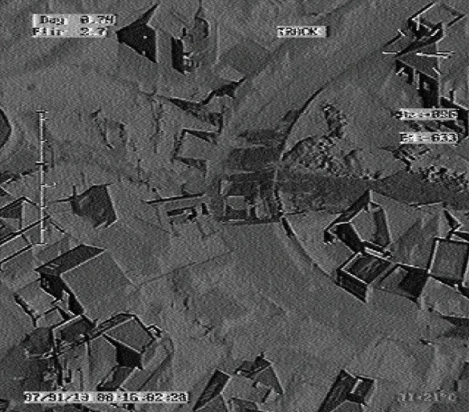
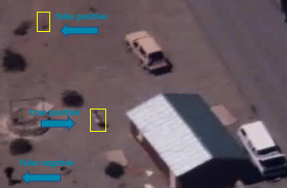
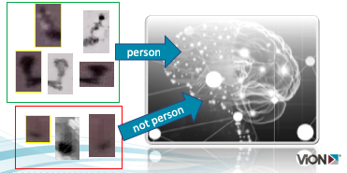
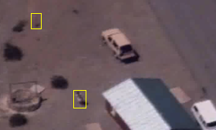
DevOps Cycle
production
validation
algorithm induction
inference

Slide 6
Customer Requirements
Complex GOTs solution, lacking support
Boost accuracy, avoid re-certification
Improve performance, induction / inference speed
Easy button, don’t require data scientist

Slide 7
Give me an ‘easy button’
Dataiku

Slide 8
Enterprise, End-to-End, Self-Service
Artificial Intelligence
Deep Learning
Machine Learning
Data Science

Slide 9
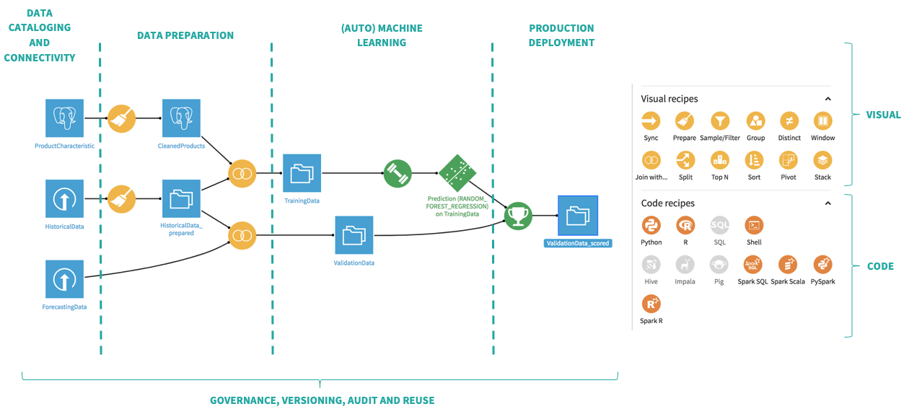

Slide 10
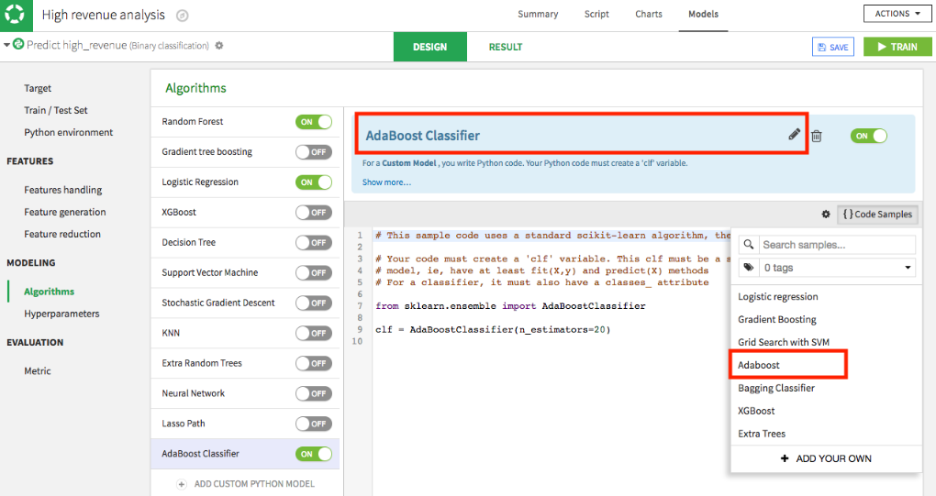
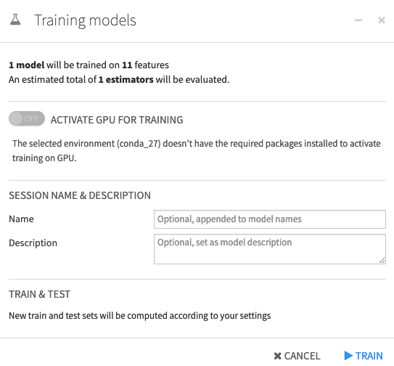
GPU Optimize
GPU optimize (if possible)

Slide 11
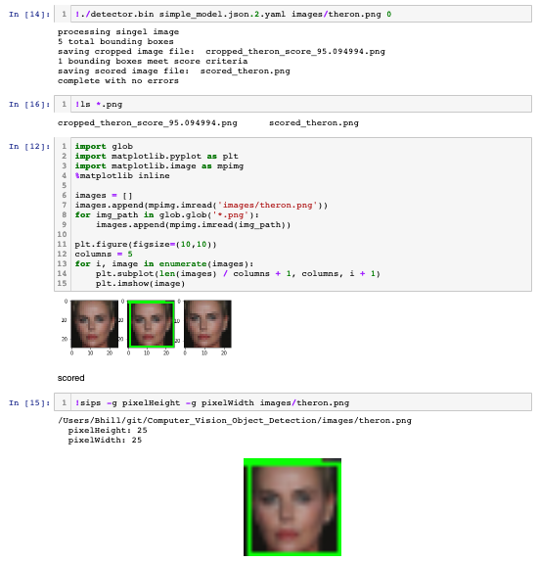
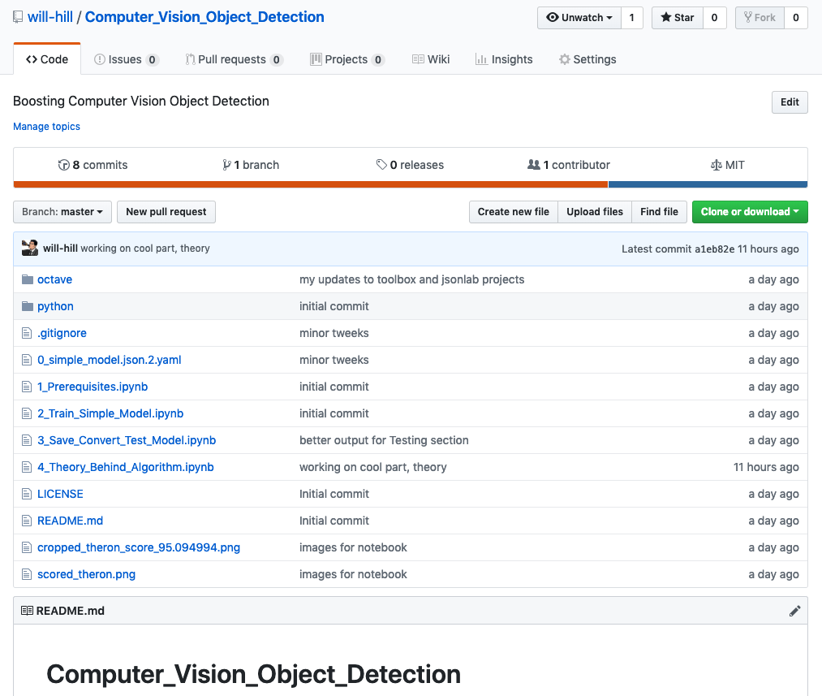
Jupyter Notebook Proof-of-Concept
Notes:
https://www.youtube.com/watch?v=LsK-xG1cLYA

Slide 12
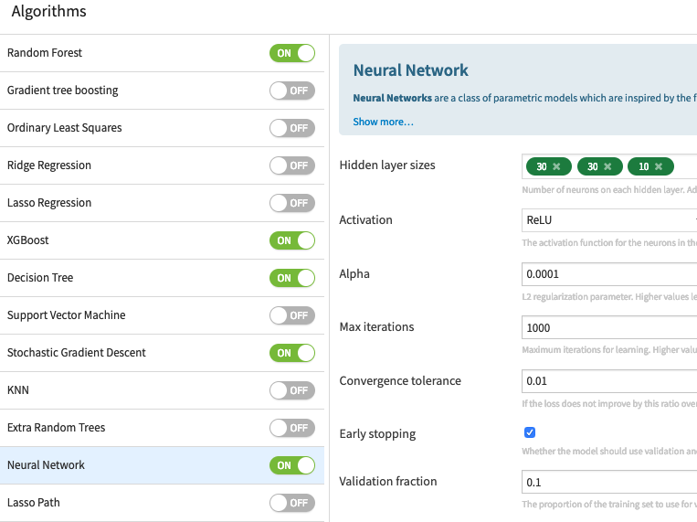
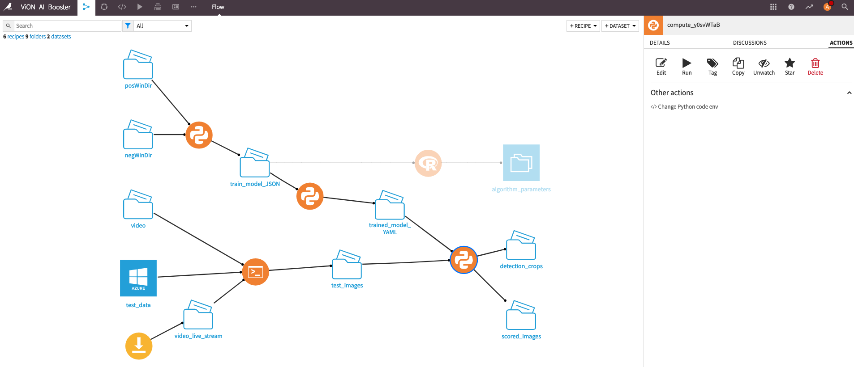
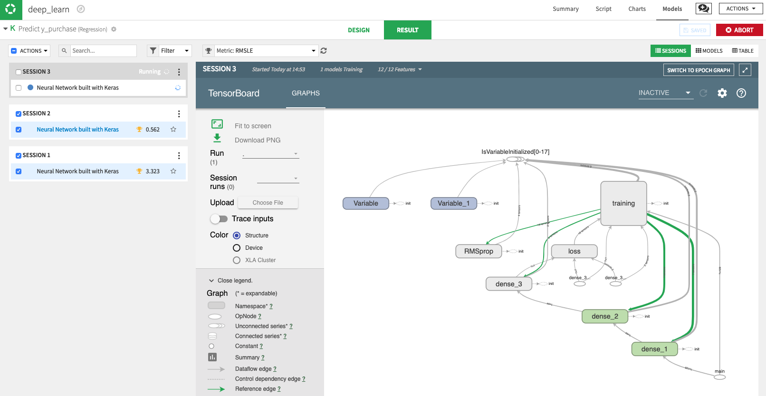
Easy Button Dataiku
easy button
induce / build
Notes:
https://www.youtube.com/watch?v=LsK-xG1cLYA

Slide 13
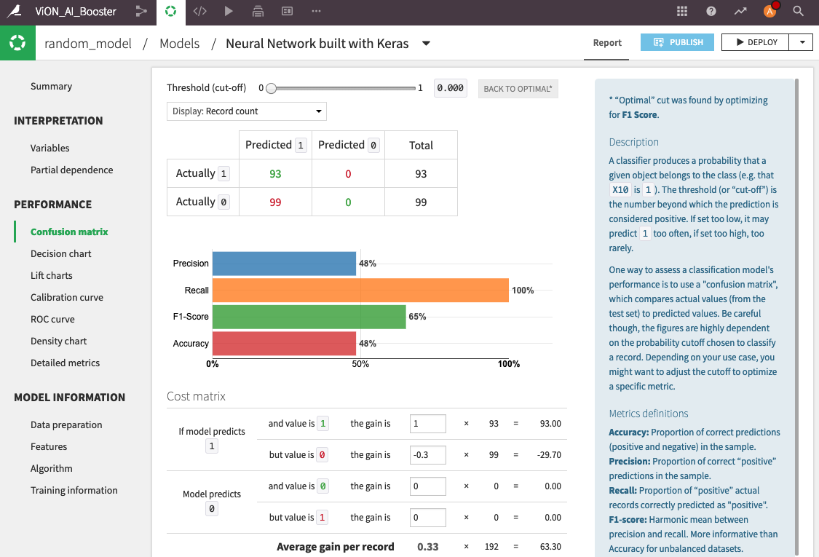
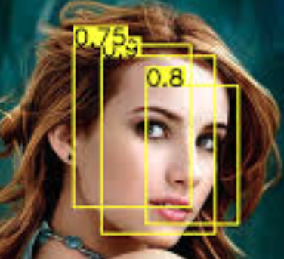
Easy Button Dataiku
deploy
Notes:
https://www.youtube.com/watch?v=LsK-xG1cLYA

Slide 14
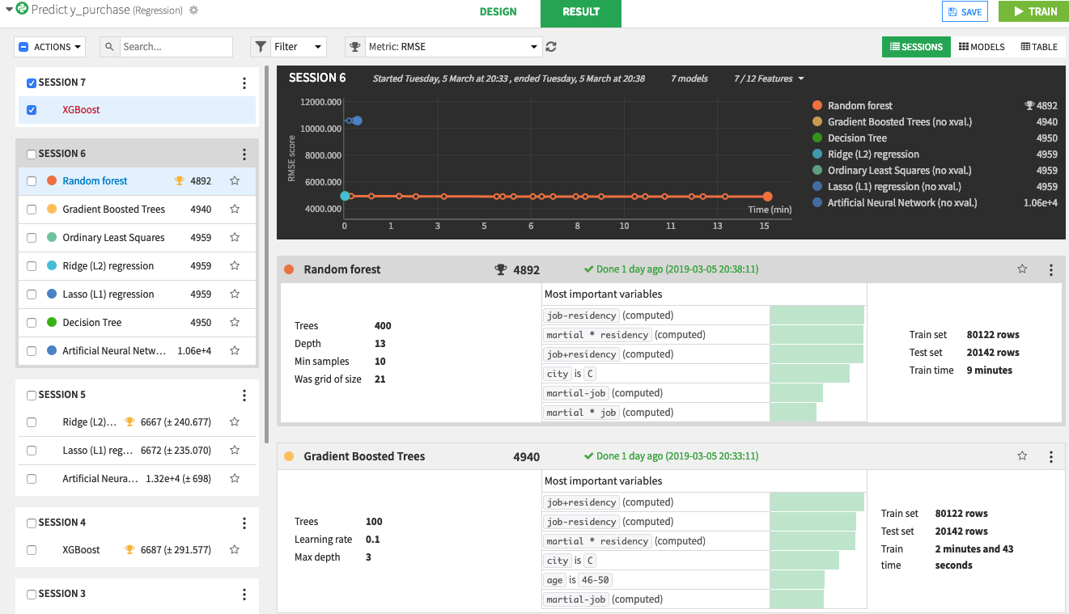
Easy Button Dataiku
test / validate
Notes:
https://www.youtube.com/watch?v=LsK-xG1cLYA

Slide 15
Easy Button Dataiku
production
Notes:
https://www.youtube.com/watch?v=LsK-xG1cLYA

Slide 16

Warning
Algorithm Explained

Slide 17
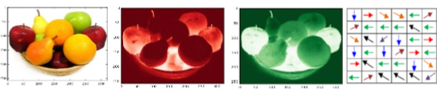
Algorithm Explained
image pyramids
aggregate feature channels (afc)
train adaboost tree ensemble
non-maximal suppression (nms)

Slide 18
What is an image or frame?

Slide 19


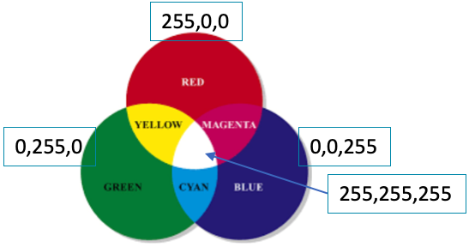

Matrix of Pixels
R:112
G:26
B:20
R:109
G:49
B:39
R:188
G:56
B:49
R:95
G:45
B:27
Matrix of pixels
Each pixel is typically 3 integers
Intensities of red, green, blue (rgb)

Slide 20

Convolution Explained
convolution
image
kernel

Slide 21
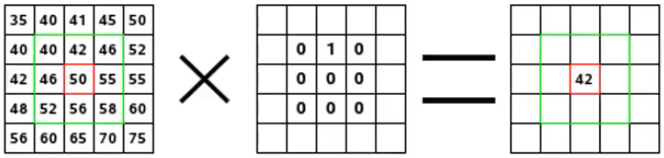
Convolution – kernel applied to pixels
images pixels
kernel
convolution

Slide 22
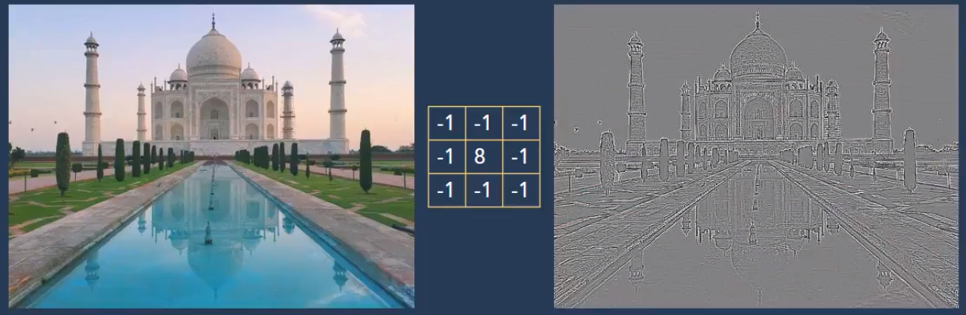
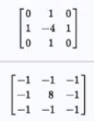
Example Kernel – remove neighbor color
Continuous areas -> grey
Discontinuities -> black & white lines

Slide 23
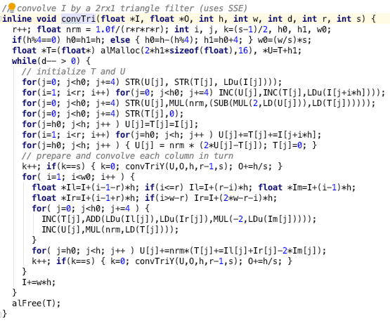
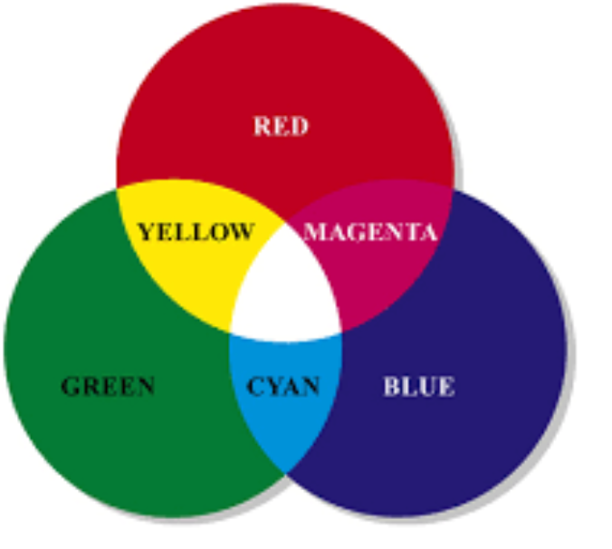
Channels Colors
So many for loops…
ripe for GPU optimization
red
green
blue
255,0,0
0,255,0
0,0,255
255,255,255

Slide 24
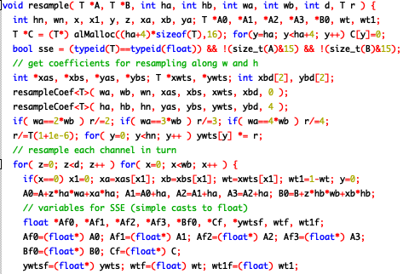
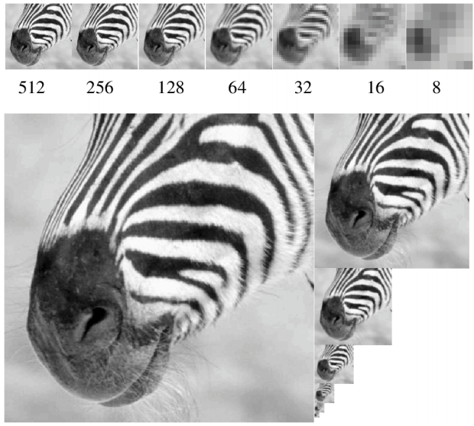
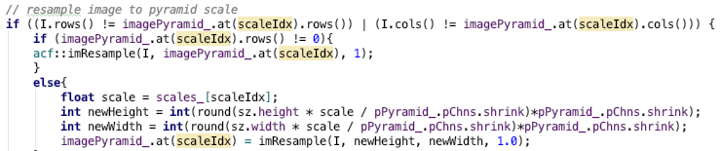
Image Pyramids
looped computations; embarrassingly parallel
order of magnitudes faster with GPU

Slide 25
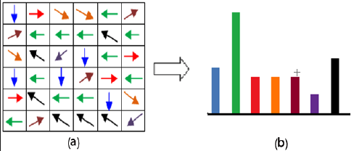
Channels Gradients, Histograms
12 | 34 | 143 | 201 | 255
12 | 34 | 143 | 201 | 255
12 | 34 | 143 | 201 | 255
12 | 34 | 143 | 201 | 255
12 | 34 | 143 | 201 | 255
Gradient Direction/Orientation
As Histogram
Gradient Magnitude

Slide 26
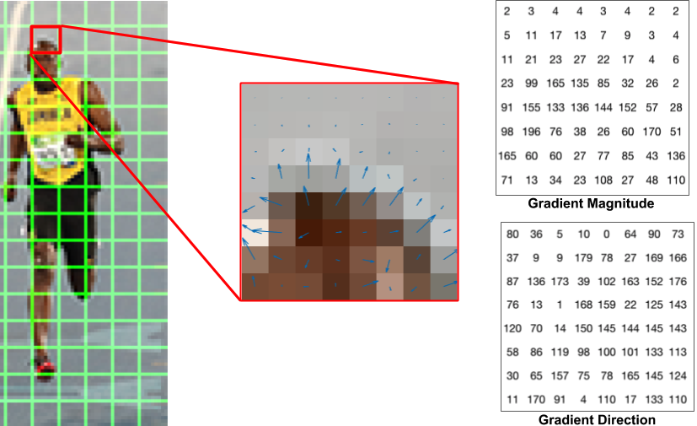
Another Gradient Explanation

Slide 27
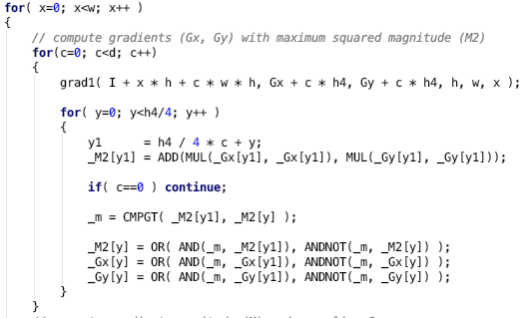
Gradient Calculations
nested for loops;
perfect for GPUs

Slide 28
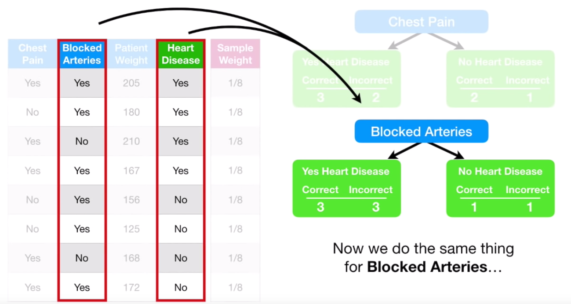
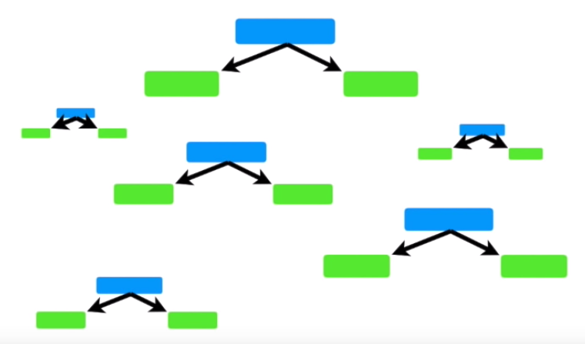
AdaBoost Ensemble Weighted Decision Trees
AdaBoost
Gradient Boosting
XGBoost
Notes:
https://www.youtube.com/watch?v=LsK-xG1cLYA

Slide 29
AdaBoost Ensemble Weighted Decision Trees
bounding boxes with probability

Slide 30
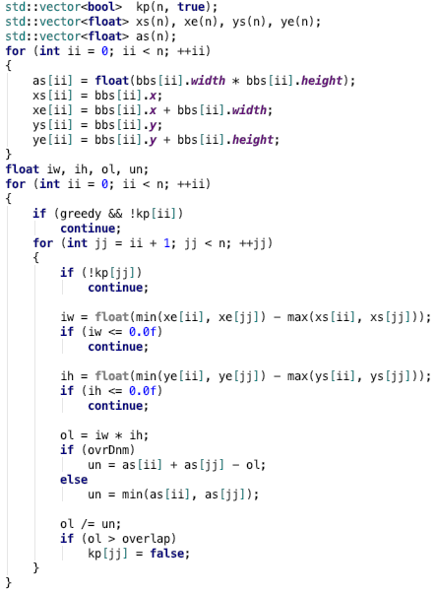
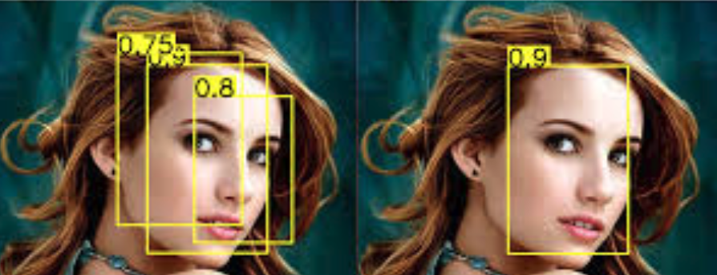
Non-Maximal Suppression
1. overlap?
intersect area / union area > 0.5 ?
2. if overlap, choose best score
nested for loop computations;
begging for GPU

Slide 31
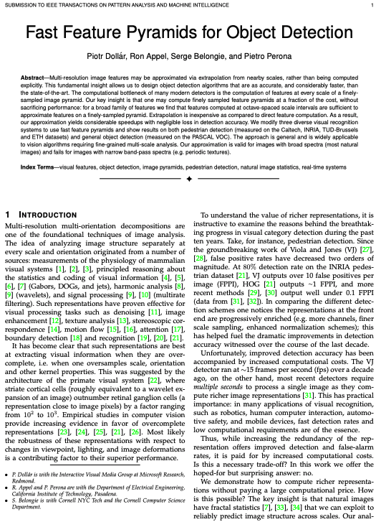
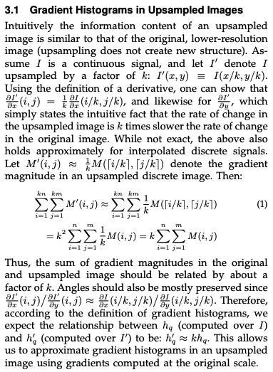
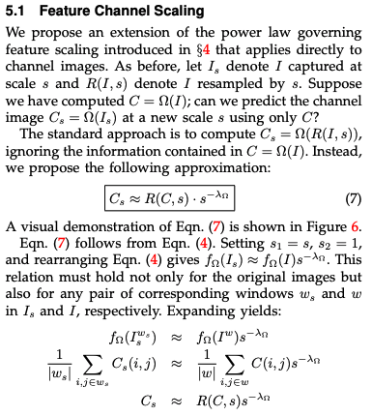
Object Detection w/ Fast Feature Pyramids

Slide 32
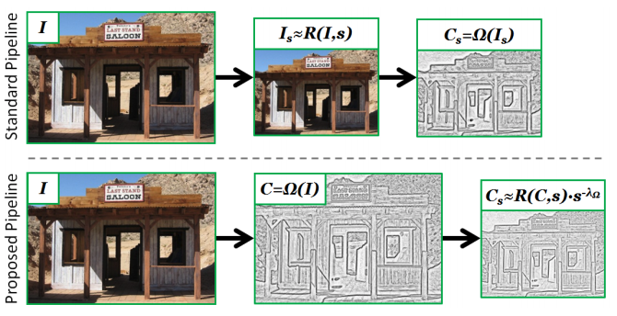
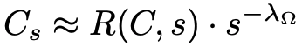
Object Detection w/ Fast Feature Pyramids
“natural images have fractal statistics that we can exploit to reliably predict image structure across scales”

Slide 33
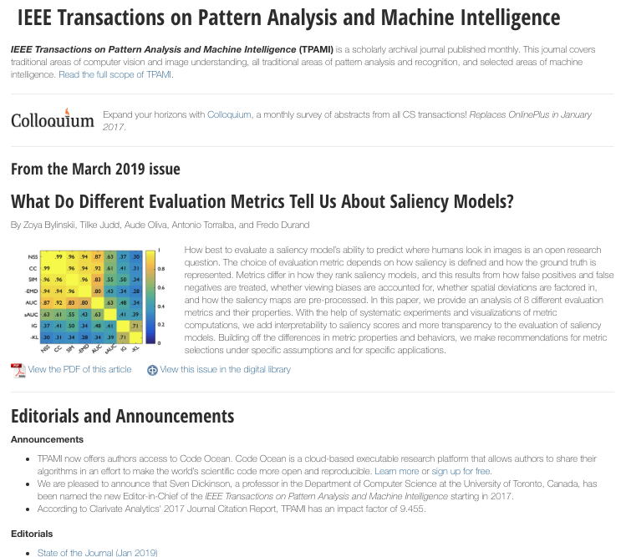
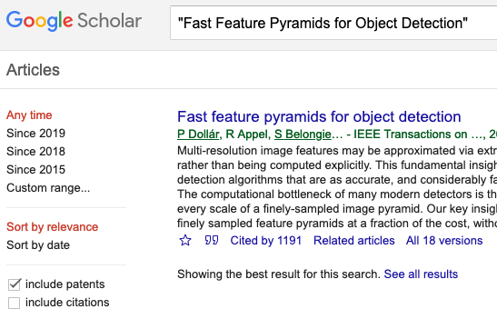
14 dense pages https://eeexplore.ieee.org/xpl
Cited 1191 times!!!

Slide 34
Questions?
Self-Service AI & Deep Learning
William Hill
Lead Data Scientist
william.hill@vion.com
github.com/will-hill

